Slide 1


RATING PREDICTION PROJECT
Presented by:
PUJA SHAHI

Slide 2
INTRODUCTION
Rating of a Product defines the feedback or improvement of quality, comfortness, price, demand for a customer.
Customers gives reviews on their purchased products on the product selling or ecommerce websites. Along with the review customers gives rating to the products out of 5 or out of 10.

Slide 3
Companies watch these ratings and reviews and try to resolve the problem with customer, improvement of the product or services in future.

Slide 4
PROBLEM STATEMENT
To Build a model which can be used to predict the rating in the range of 1-5 to sort out the reviews in positive and negative portions.
5 is the best rating whereas 1-2 are lowest ratings.
Also some reviews which are either 3-4 can be categorized for improvement the quality of the product.

Slide 5
Tools Used
Anaconda 2020.07
Jupyter Notebook 6.0.3
Python 3.8.3
Numpy
Pandas
Scikit Learn
Matplotlib
Warnings
Seaborn
Machine Learning
Natural Language Processing

Slide 6
Model Designing Procedure
Web Scraping Data from Amazon and Flipkart
Exploratory Data Analysis (EDA)
Visualization
Data Preprocessing using NLP
Preparing Input and Target Variables
Model Designing, Evaluation and Finalization
Conclusion

Slide 7
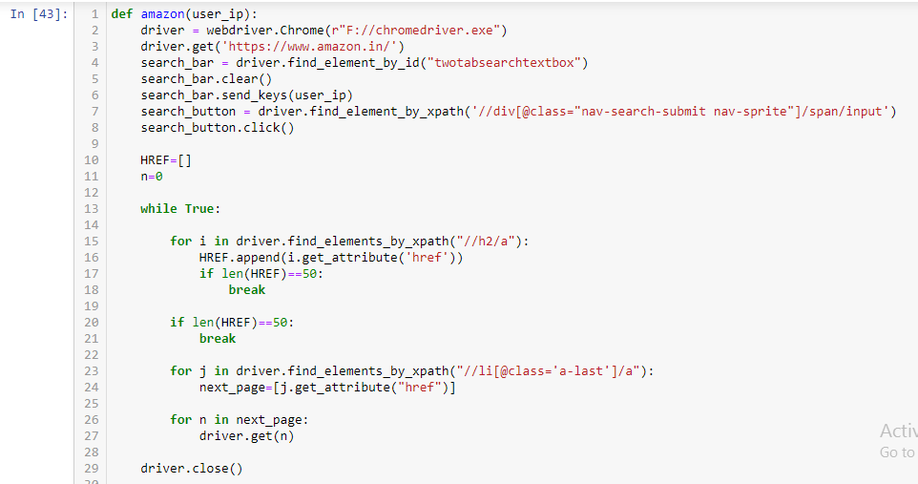
Web scraping
Web Scraping using following functions for Amazon and Flipkart

Slide 8
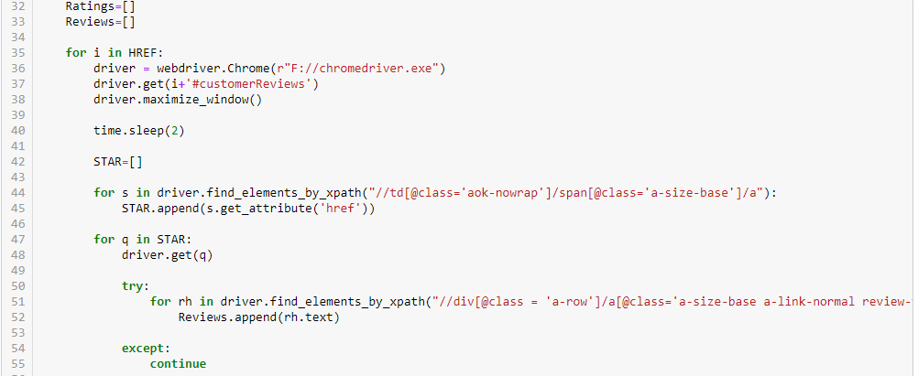
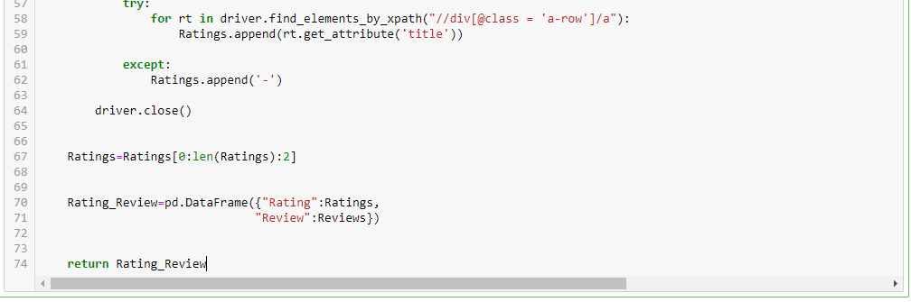

Slide 9
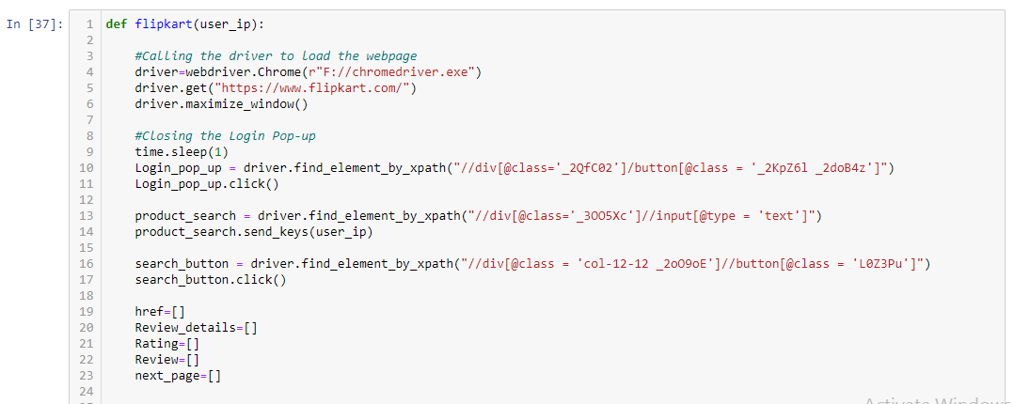
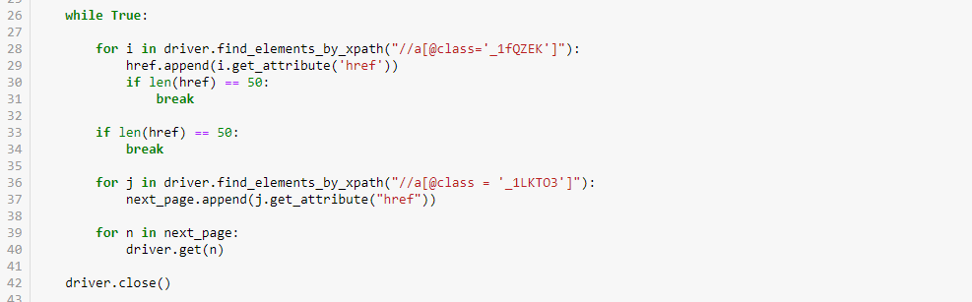

Slide 10
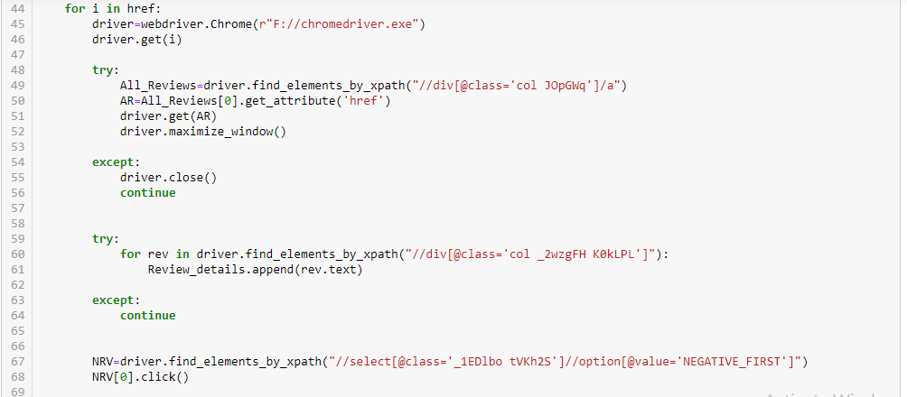
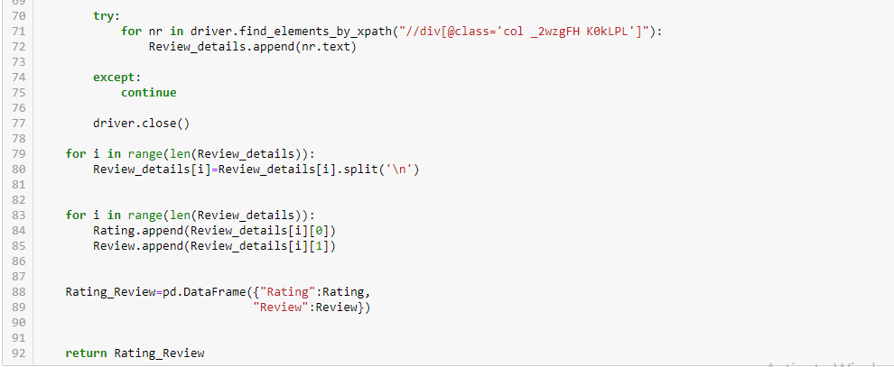

Slide 11
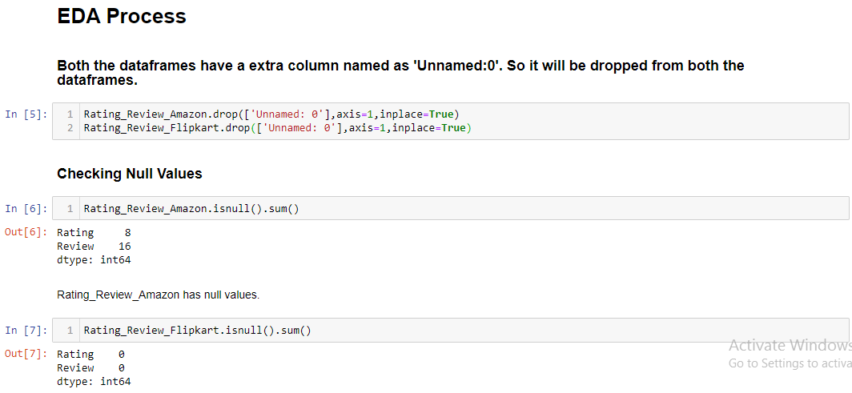
Exploratory Data Analysis (EDA)
After Web Scraping the two datasets from Amazon and Flipkart are undergone in EDA process.

Slide 12
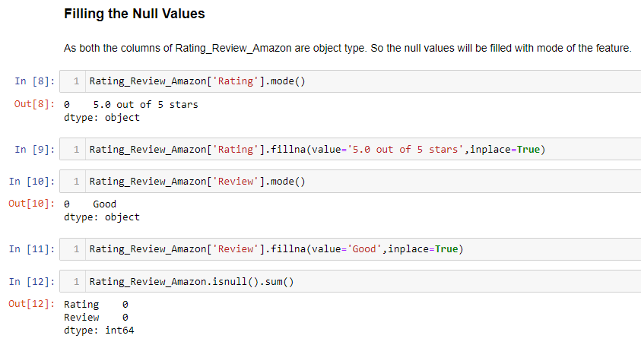
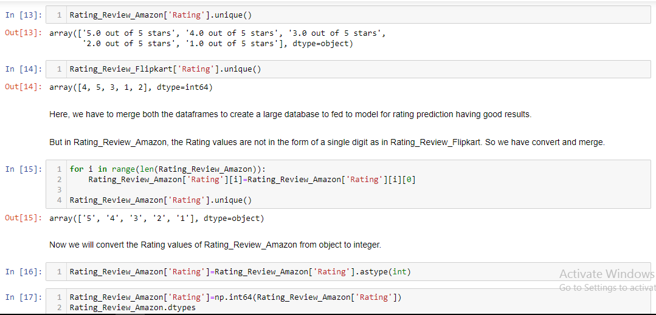
Converting String to Integer of Amazon Scrapped Data’s Review

Slide 13
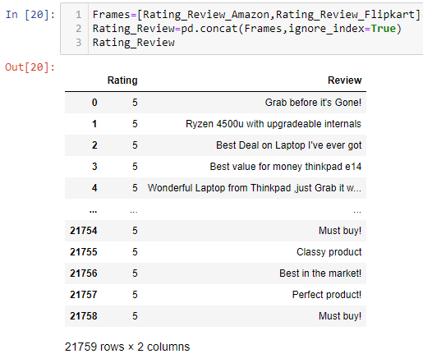
Now the two dataframes are merged into one. It is the required dataframe for model building.

Slide 14
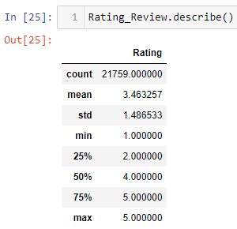
The describe() method says the dataframe is left skewed.

Slide 15
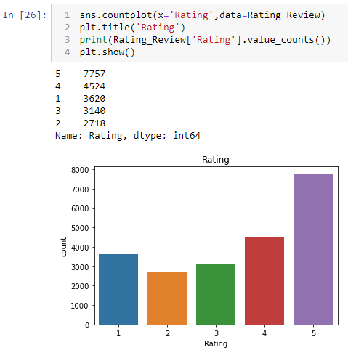
VISUALIZATION
The Rating is slightly imbalanced due to high number of 5 star rating with compare to others.

Slide 16
DATA PREPROCESSING USING NLP
The Review is processed using Lemmatizer, Vectorizer to form a matrix like dummy variable for each word.
Stopwords are not removed because of negative ratings as it contains not group which defines negative reviews.

Slide 17
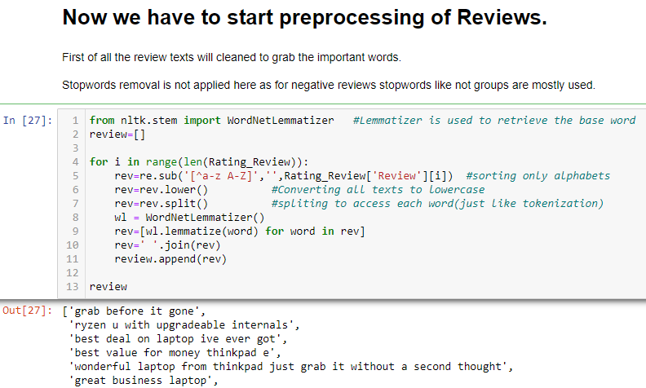
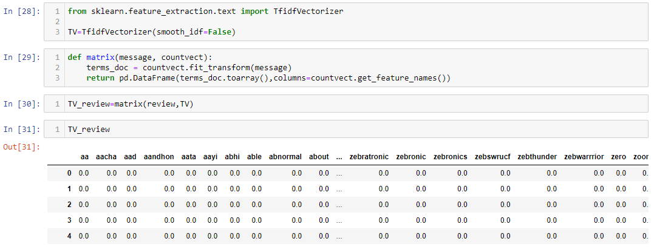

Slide 18
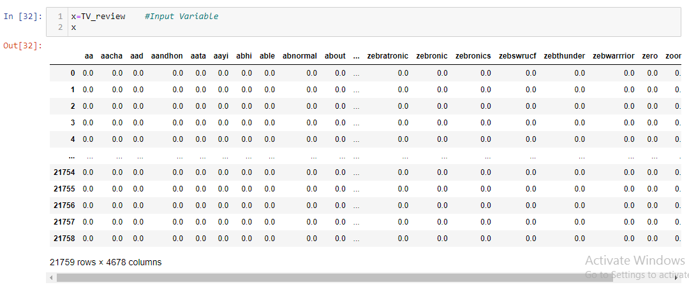
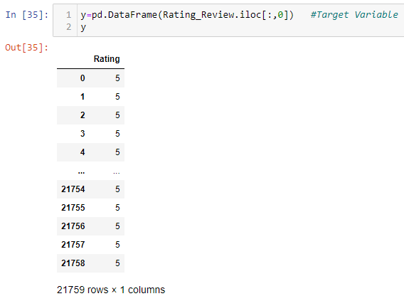
PREPARING INPUT AND OUTPUT VARIABLE

Slide 19
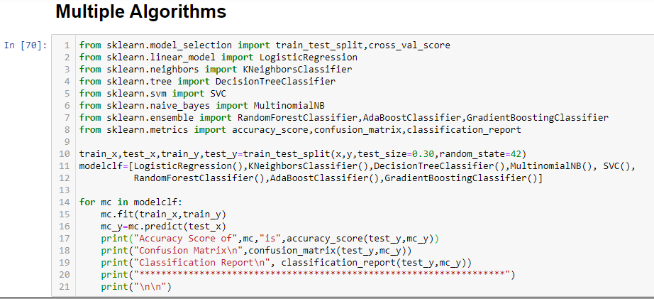
MODEL EVALUATION
All Classifier Algorithms are used to build the model.

Slide 20
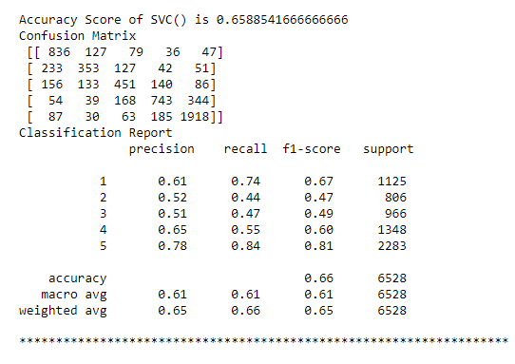
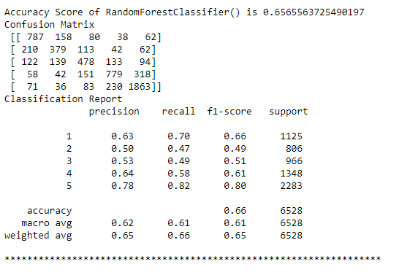
The Best Models are SVC() and RandomForestClassifier().

Slide 21
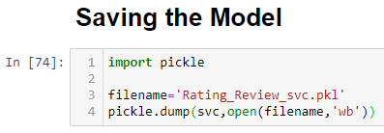
Now Saving the Model for SVC().

Slide 22
CONCLUSION
From this model analysis, it is understood that model accuracy is not that great. This means the review to rating prediction may be needed more learning. Some Oversampling or Undersampling may be applied for balancing the dataset. This model help to predict the reviews of any product for a company.

